Slide 1
Keeping a story Alive
TIPS FROM STEVE RUBEL
5 big changes in media
Stories are social.
Quick expansion of media channels. In 2 days, we can store all information that existed before 2003.
We live in a multi-screen world.
Stories do not last forever.
Every company is now a media company.

Slide 2
3 THINGS THAT HAVEN’T CHANGED
Time and attention are finite
We love a good story. Stories connect people.
Content is king. Good writing and storytelling will prevail.

Slide 3
TRANSMEDIA STORYTELLING:THE MEDIA CLOVERLEAF™
Concept developed by Edelman
People need to hear things three to five times over and over – seen over the last two years based on research
Challenge: how to keep a story alive as long as possible?

Slide 4
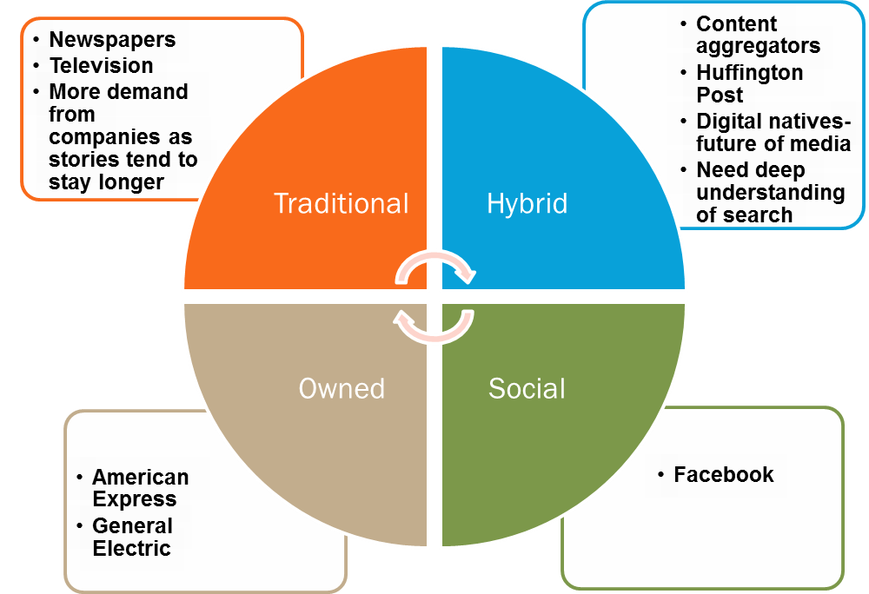
TRANSMEDIA STORYTELLING:THE MEDIA CLOVERLEAF™

